Slide 1
The Production and Consumption of Tourism

Slide 2
Tourism is a productive activity consisting of 3 main components:
The country of origin of the tourists
The tourist destinations
The routes travelled between the destinations

Slide 3
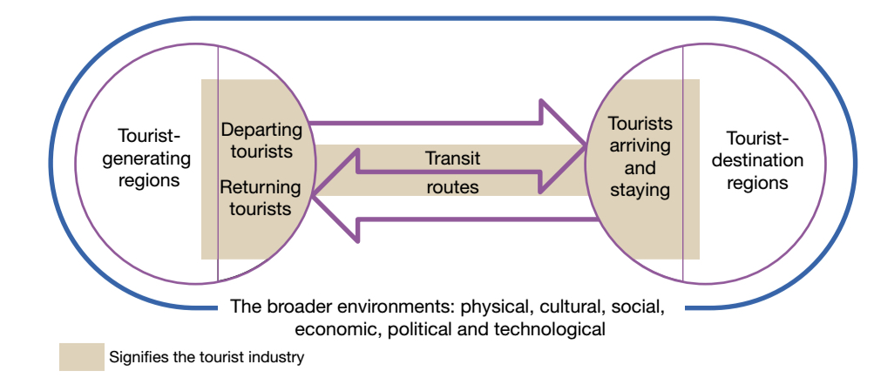

Slide 4
Tourism: Production and Consumption
Tourism destination areas attract tourists by offering what isn’t available at home.
Activities include: accommodation, retailing and service functions, entertainment and recreation.

Slide 5
Tourism: Production and Consumption
Transit Routes link the two areas of economic activity
Key element in the efficiency and the size and direction of tourist flows

Slide 6
Tourism: Production and Consumption
A complex set of industries is involved in the supply of goods and services to tourists.
A large number of small, independent firms tend to operate alongside a few, multinational corporations.

Slide 7
Tourism: Production and Consumption
How is Tourism consumed?

Slide 8
Tourism: Production and Consumption
Tourism services are delivered directly to the consumers while on holiday.
Most goods and services demanded by tourists are consumed in situ, that is in the places where they are offered. Eg; accommodation, food consumption, entertainment, tours.
A lot also takes place en route to the destination

Slide 9
UNIT 8.4 Tourism: Production and Consumption
Read and answer activities 1 – 4 on page 296

Slide 10
The likely future changes in the nature and spatial distribution of the production and consumption of tourism.
Syllabus Point.

Slide 11
Tourism: Changing production processes
Growth of tourism throughout the 20th century associated with rising living standards in the developed world
Post WW2, saw rapid economic growth and the introduction of paid holiday leave which enabled lower income groups to travel
Advancements in transportation – motorcar and aircraft
New forms of accommodation, tour operators, marketing efforts all contributed to this rapid growth in the industry

Slide 12
Internationalisation of Tourism
Tourism has become globalized
Due to technological advances – ease of communication, safer, more comfortable and accessible travel
Global transportation infrastructure = ‘seamless, interconnected pathway’ to all parts of the world
Most significant development = China as the #1 source market for outbound tourists since 2012, increased prosperity of the Chinese middle class has lead to the growth in outbound tourism

Slide 13
Organisational Developments
Organisation = framework within tourism operates
2 sources – government and private sector

Slide 14
Government
Tourism has an impact on local, regional and national economies
National tourism organisations have been established to promote tourism within their countries (Tourism Australia, Tourism WA)
Geared towards international promotion and marketing

Slide 15
Private Sector
Can range from small to large scale operations
Such as owner-operated businesses, Airbnb to large multinational corporations

Slide 16
Changes in Production: SUMMARY
Production is becoming more globalized
Governments recognize the importance of tourism as an economic activity and work to promote tourism in their countries
Private sector businesses are emerging rapidly, more multinational corporations are working to encompass the entire tourism experience
Tourists are demanding less “sedentary, relaxing holidays” and more “experience oriented holidays”

Slide 17
Unit 8.5 Tourism: changing production processes
Pages 297 – 298
Activities 1 - 6

Slide 18
Tourism: Changing Consumption Patterns
Tourism is driven by individual consumer decisions
As more people are exposed through media to other cultures, languages and environments, the desire to see them first-hand increases.

Slide 19

Package Tours
Convenience of buying a single travel product
Transport, accommodation, ancillary services (entertainment)
Package tours retain a mass appeal
Eg: Contiki Tours, Topdeck

Slide 20

Small Group Tours
For those who reject the mass-produced package tours, these are a popular alternative
Average group size – 16 people
Provide an enjoyable and personal experience
Better for the environment, less impact and disruption
Eg: G Adventures

Slide 21
Individual Travel
Many consumers are becoming more selective, actively planning their own travel experience
Prefer to individualize their itinerary
Depends on their experience, resources and nature of the experience they seek

Slide 22
Unit 8.6 Tourism: changing consumer patterns
Pages 300 – 302
Activities 1 - 9

